Slide 1
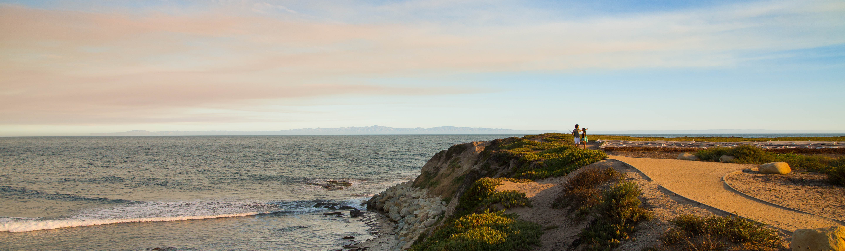



Reproducing and Replicating Spatial Data Science
Joseph Holler, Peter Kedron, and Sarah Bardin
HEGSRR.github.io
Funding Support from NSF BCS-2049837, NSF OAC-1743184

Slide 2
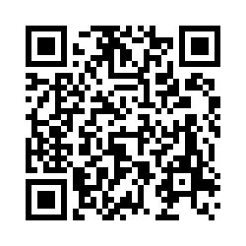
Tell us what you think
Please take 2mins to complete a short survey about open science research practices
go.middlebury.edu/hegsrr
Protocol
Sort 11 open and reproducible research practices (ORRP)
Already using
Aware and interested in using
Unaware or uninterested
10 likert technology adoption questions
Share deidentified data
Follow-up surveys (immediate, one year)

Slide 3
Defining Reproducibility and Replicability
A brief definition for spatial data science

Slide 4
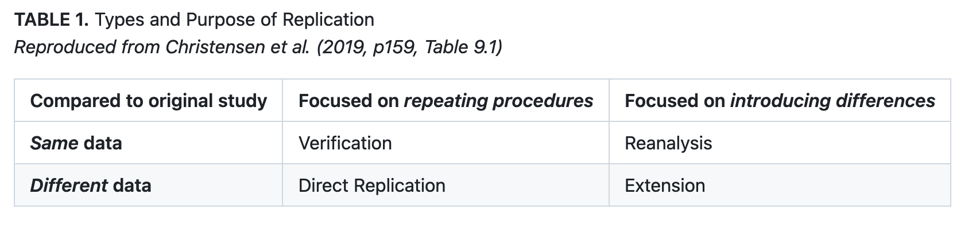
Reproduction and Replication
(Schmidt 2009, Gomez et al. 2010, Barba 2017, Christensen et al. 2019, NASEM 2019)

Slide 5
Reproduction and Replication
(Schmidt 2009, Gomez et al. 2010, Barba 2017, Christensen et al. 2019, NASEM 2019)
Reproduction
Same data, same procedure, same results, same context

Slide 6
Reproduction and Replication
(Schmidt 2009, Gomez et al. 2010, Barba 2017, Christensen et al. 2019, NASEM 2019)
Reproduction
Same data, same procedure, same results, same context
Replication
New data, similar procedure, similar results, same or new context

Slide 7
Veridical Spatial Data Science
Munafo et al. (2016), Kedron et al. (2020), Yu & Kumbier (2020)
Principled inquiry to extract reliable and reproducible information from spatialtemporal data, with an enriched technical language to communicate and evaluate empirical evidence in the context of human decisions, domain knowledge, and geographic confounds; supported by a system of external validation and evidence accumulation based on the purposeful replication of findings across space and time.
(Adapted from Kedron and Bardin 2021, Yu and Kumbier 2020)

Slide 8
Our R&R Related Resources
Munafo et al. (2016), Kedron et al. (2020), Yu & Kumbier (2020)
5 Peer-reviewed Publications
8 Reproduction and Replication Studies
2 Surveys of Researcher Practices
Reproducible Project Repository Template
Manual In Development
2 Course Syllabi
9 RAs Mentored
~50 Students Engaged in R&R Studies

Slide 9
Survey Results
The reproducible research practices you identified as interesting and important

Slide 10
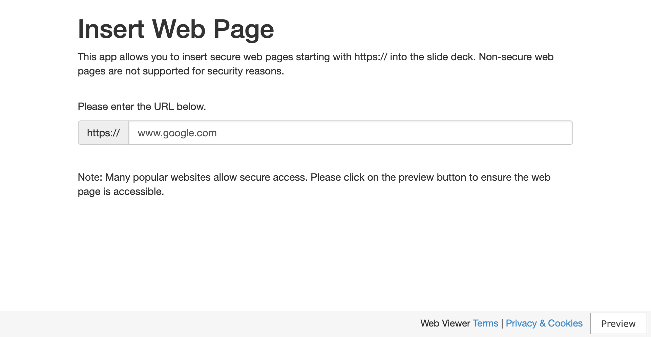
Link to Report

Slide 11
Open and Reproducible Research Practices
A quick review of practices in light of the survey results

Slide 12
Share Data
Do you make the data for your study readily available in the most complete and unmodified form permissible by law and ethical protocols?

Slide 13
Share Methods and Code
Rmarkdown, Jupyter Notebook, Scripts, Models, Protocols
Do you share a complete description of your methods?

Slide 14
Metadata
Dublin Core, ISO 191**, Federal Geographic Data Committee (FGDC)
Do you provide information about your study and each of its components in a standardized format?

Slide 15
Version Control
Git, GitHub, GitLabs, OSF projects
Do you manage and track changes to your study design, data, and code?

Slide 16
Research Compendium
HEGSRR Template, TIER Protocol, WORCS, o2r
Do you collect all components of your study together in a directory organized with consistent structure and relative links?

Slide 17
Digital Archive with DOI
DOI: Digital Object Identifier
Are all the components of your study digitally archived for long-term preservation, and labelled and linked with a persistent digital object identifier?

Slide 18
Open Licensing
Creative commons, BSD-3, GPU, MIT…
Do you license your research products to allow others to use, modify, and redistribute them?

Slide 19
Open Source Software
Python, R, PostGIS, GeoDA, QGIS
Do you use and cite research software with (re)distributable source code?

Slide 20
Reproducible Computational Environment
Docker container, public cyberinfrastructure, environment metadata
Do you provide access to your computational environment or sufficient information about your environment such that others can recreate it?

Slide 21
Reproduction and Replication Studies
Do you attempt and share
reproduction or replication studies?

Slide 22
Preregistration
OSF, AsPredicted, Registered Reports
Do you publicly register your hypotheses and research design before conducting your work?

Slide 23
HEGS-RR Infrastructure
A project-based demonstration of our infrastructure for reproducibility and replicability

Slide 24
Open Discussion
We invite questions, feedback, and discussion about R&R in spatial data science

Slide 25
Discussion prompts
and invitation to collaborate…
What barriers do you perceive to adopting open and reproducible research practices in your own scholarship (research and teaching)?
Could any resources or changes help overcome those barriers?
How can we further improve infrastructure for reproducible and replicable scholarship in spatial data science?
Can you share any successes, advice, or best practices introducing reproducibility and replicability in your spatial data science scholarship?

Slide 26
Conclusions
Example Studies – Reproducibility – Internal Validity Spatiotemporal Metascience – Collaboration
Follow our work at
HEGSRR.github.io
(with links to OSF and GitHub)
opengisci.github.io
(GIScience course at Middlebury)
Notes:
To conclude, we have a growing set of example R&R studies for use in teaching or future metascience,
Each of the studies is now more reproducible than the original,
We have checked their internal validity by attending to and reanalyzing researcher decisions and deviations,
We hope wide adoption of our template or something similar would enable spatiotemporally explicit metascience – series of replications or metaanalyses
And finally, we invite feedback and collaboration, and hope that the many individual efforts to advance open spatiotemporal data science are reaching a critical mass ready for collaboration and scaling.

Slide 27
Veridical Spatial Data Science
Munafo et al. (2016), Kedron et al. (2020), Yu & Kumbier (2020)
Question
Communicate
Research Design
g
a
b
Data
Collection
Interpret
f
abcdefg = n
e
c
Data
Management
d
Modeling
& Analysis
Data
Exploration

